Slide 1
COMP 2710 Software Construction
Testing
Debugging and Testing Functions
Dr. Alvin Lim
Auburn University
http://www.eng.auburn.edu/~lim
limalvi@auburn.edu
Fall 2014
These slides are adapted from notes by Dr. Winard Britt

Slide 2
Designing Test Cases and Testing
How can we demonstrate success?
How do we know if we’ve failed?
Did we do what we set out to do in the first place?
How do we guarantee robustness of our system?

Slide 3
Test Cases
Should always be designed BEFORE you ever write the first line of code. Ideally, somebody who isn’t you should write them.
Test cases should be carefully designed to make sure that the system does what it is intended to do and that it does it correctly!
Inspiration comes from ANALYSIS and DESIGN

Slide 4
Types of Testing
Unit Testing
  Isolate a single function or class and test only that. This generally requires holding other functions constant or at least making them predictable (remember drivers and stubs?)
System Wide/Integration Testing
  Does the whole system meet its goals?
  Does the whole system work correctly?
  System Test Cases should map back to Use Cases!

Slide 5
How to know what to test?
Bugs hide in corners
  Check normal cases and boundary cases
  Divide the possible input space into equivalence classes (!). Exhaustive testing is neither practical nor necessary.

Slide 6
Testing Functions
  Examples for values:
  string – empty string, medium length, very long
  Array – empty array, first element, last element
  Int – zero, mid-value, high-value
Testing the preconditions/postconditions:
  Are they true?
  Boolean logic, assertions

Slide 7
Testing Objects
Think of a series of operations (preferably the way the object will be used)
Instantiate the object and run it through the gauntlet, make sure you get desired effects

Slide 8
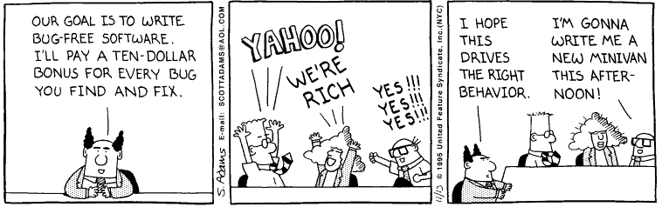
Yahoo!

Slide 9
Implementation (Easy, right?)
Convert the Objects in Design into Classes in code
Convert attributes into member variables
Convert operations into member functions
Design Objects separately, unit test
Later, perform integration test

Slide 10
Class Test Case Design
Identify each test case uniquely
- Associate test case explicitly with the class and/or method to be tested
State the purpose of the test
Each test case should contain:
  A list of messages and operations that will be exercised as a consequence of the test
  A list of exceptions that may occur as the object is tested
  A list of external conditions for setup (i.e., changes in the environment external to the software that must exist in order to properly conduct the test)
  Supplementary information that will aid in understanding or implementing the test

Slide 11
Design Principles
Low Coupling
  Objects/Modules should be able to stand on their own. When objects are highly coupled, it hurts reuse, readability, and flexibility. Can be identified on Class Diagrams. Can be added by combining similar classes or by using generic classes as intermediates.
High Cohesion
  Objects/Modules should have a clearly defined purpose and should only have operations associated with that purpose. Generally can be resolved by creating new classes.

Slide 12
Data Encapsulation/Information Hiding
Group things that go together…together
Only give Objects as much information as they absolutely need to know, hide all else
  Remember, design robust interfaces and force everyone to use them.

Slide 13
Integration Testing
Remember stubs/drivers – use them!
Replace stubs with unit tested functions until you have a fully working system

Slide 14
Maintenance
The single most expensive phase in software development
Why?
  The needs of the user evolves
  The problem changes
  Bugs are discovered
  The context of the system changes
    OS, cooperating modules

Slide 15
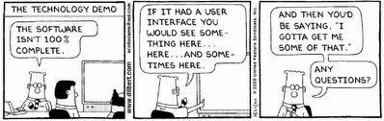
Acceptance Testing, Anyone?

Slide 16
In Our Class
Analyze the Problem (OO Analysis)
  Big Picture Analysis
  Use Cases
Design a Tentative Solution (OO Design)
  Class Diagrams
  Data Flow Diagrams
Design Test Cases (Unit and System)
Implement Functions, Classes
Unit Test -> If failure, return to 4. Else, continue
Integrate
System Test -> If failure, return to 2 or 4.
Deploy

Slide 17
Conclusion
Code responsibly, the grade you save may be your own.
Oh yeah, and you might save lives or make lots of money too. That counts too.

Slide 18
References
C. Larman, Applying UML and Patterns, 2nd Edition
W. Oates, L. Leone, et. all, Engineering Your Future, 2nd Edition
W. Humphrey, A Discipline for Software Engineering

Slide 19
Testing and Debugging Functions
Copyright © 2008 Pearson Addison-Wesley. All rights reserved.
4-<number>

Slide 20
Testing and Debugging Functions
Many methods:
  Lots of cout statements
    In calls and definitions
    Used to "trace" execution
  Compiler Debugger
    Environment-dependent
  assert Macro
    Early termination as needed
  Stubs and drivers
    Incremental development
Copyright © 2008 Pearson Addison-Wesley. All rights reserved.
4-<number>

Slide 21
The assert Macro
Assertion: a true or false statement
Used to document and check correctness
  Preconditions & Postconditions
    Typical assert use: confirm their validity
  Syntax:
  assert(<assert_condition>);
    No return value
    Evaluates assert_condition
    Terminates if false, continues if true
Predefined in library <cassert>
  Macros used similarly as functions
Copyright © 2008 Pearson Addison-Wesley. All rights reserved.
4-<number>

Slide 22
An assert Macro Example
Given Function Declaration:
void computeCoin( int coinValue,
int& number,
int& amountLeft);
//Precondition: 0 < coinValue < 100
0 <= amountLeft <100
//Postcondition: number set to max. number
of coins
Check precondition:
  assert ((0 < currentCoin) && (currentCoin < 100)
  && (0 <= currentAmountLeft) && (currentAmountLeft < 100));
  If precondition not satisfied → condition is false → program execution terminates!
Copyright © 2008 Pearson Addison-Wesley. All rights reserved.
4-<number>

Slide 23
An assert Macro Example Cont’d
Useful in debugging
Stops execution so problem can
be investigated
Copyright © 2008 Pearson Addison-Wesley. All rights reserved.
4-<number>

Slide 24
assert On/Off
Preprocessor provides means
#define NDEBUG
#include <cassert>
Add "#define" line before #include line
  Turns OFF all assertions throughout
  program
Remove "#define" line (or comment out)
  Turns assertions back on
Copyright © 2008 Pearson Addison-Wesley. All rights reserved.
4-<number>

Slide 25
Stubs and Drivers
Separate compilation units
  Each class or function is designed, coded, tested
  separately
  Ensures validity of each unit
  Divide & Conquer
    Transforms one big task → smaller,
    manageable tasks
But how to test independently?
  Driver programs
Copyright © 2008 Pearson Addison-Wesley. All rights reserved.
4-<number>

Slide 26
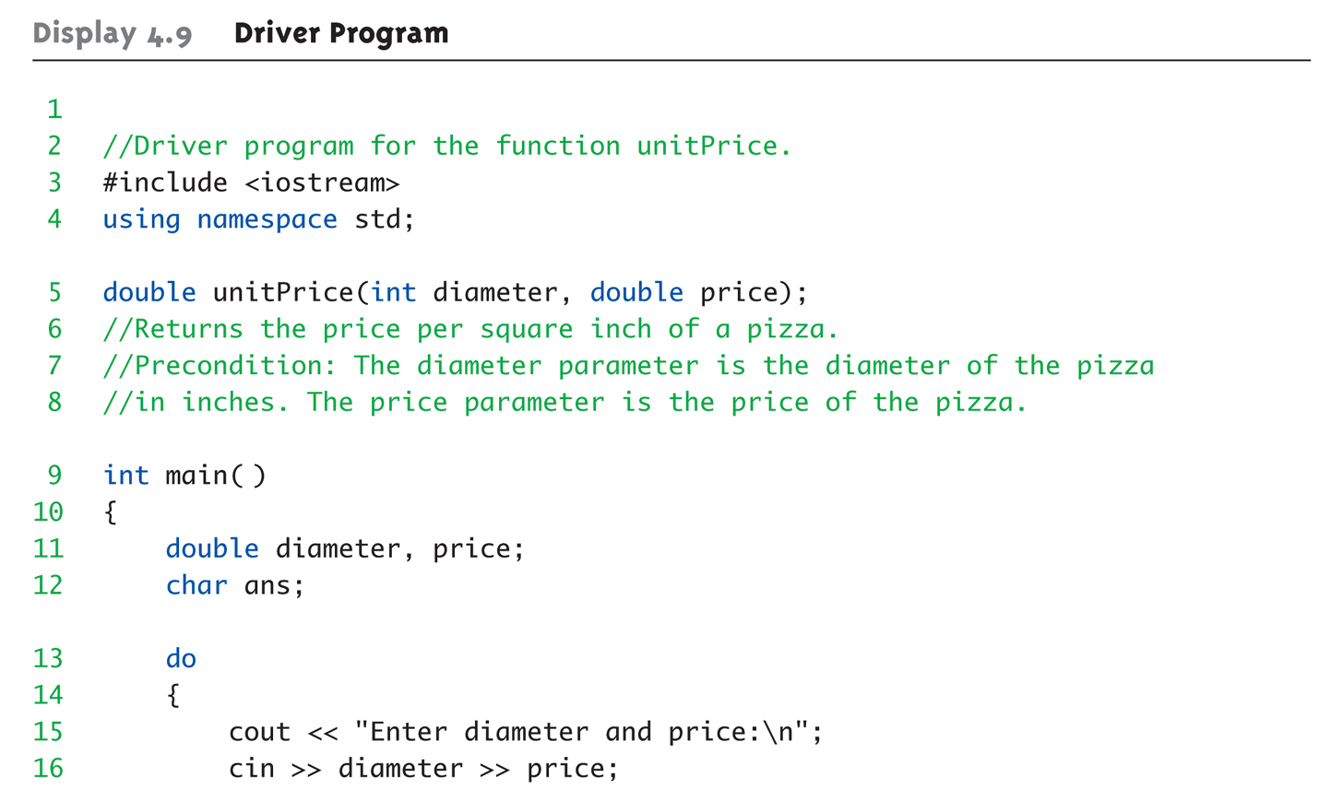
Driver Program Example:
Display 4.9 Driver Program (1 of 3)
Copyright © 2008 Pearson Addison-Wesley. All rights reserved.
4-<number>

Slide 27
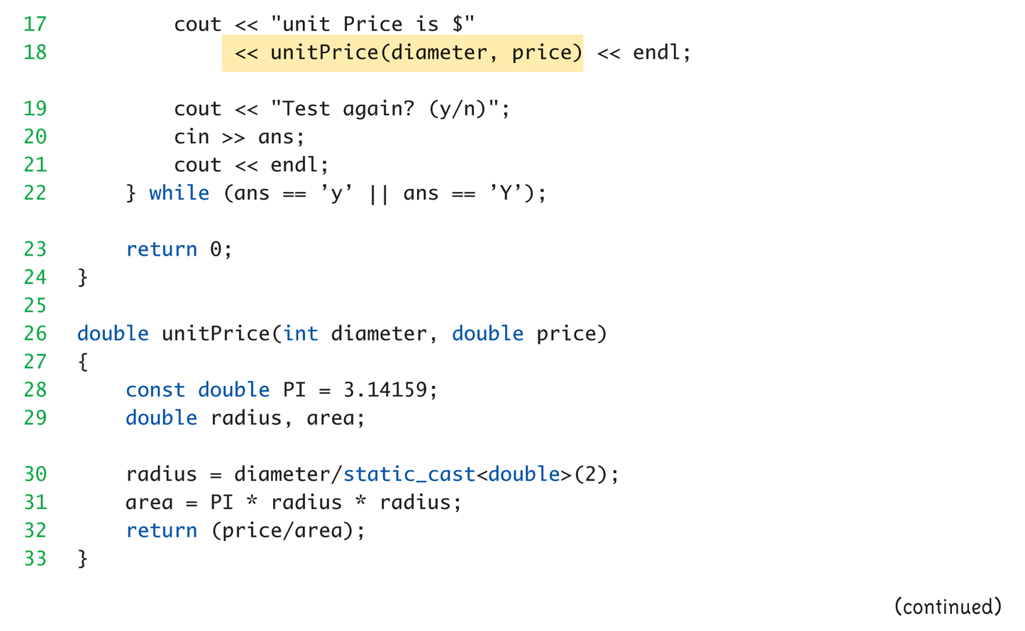
Driver Program Example:
Display 4.9 Driver Program (2 of 3)
Copyright © 2008 Pearson Addison-Wesley. All rights reserved.
4-<number>

Slide 28
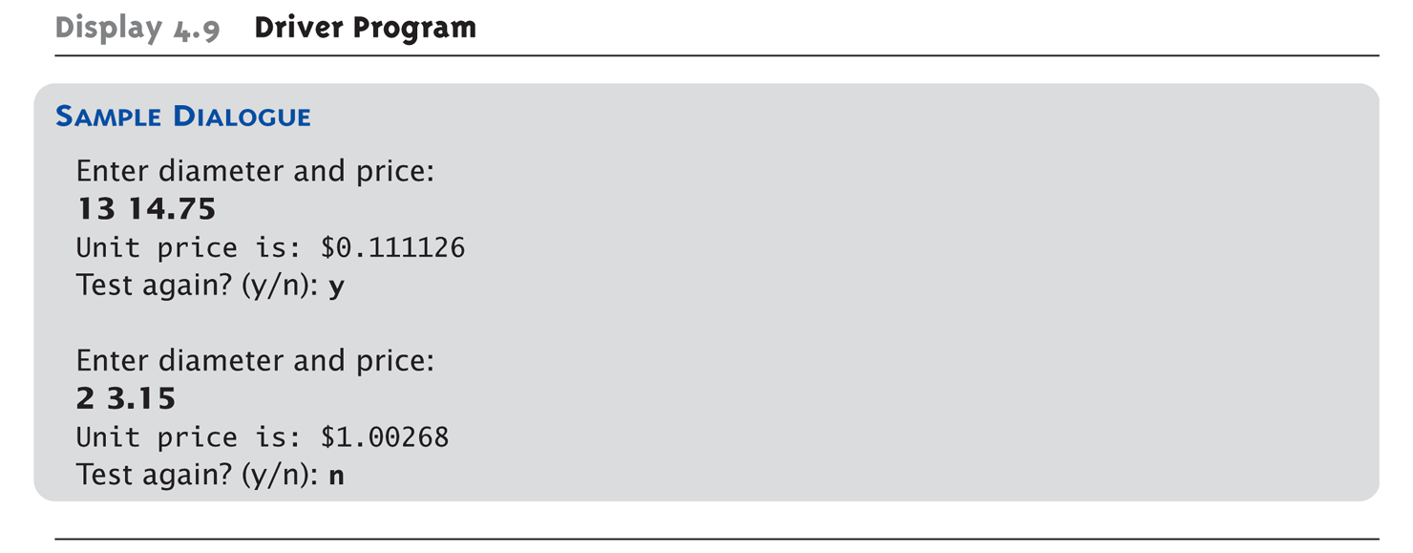
Driver Program Example:
Display 4.9 Driver Program (3 of 3)
Copyright © 2008 Pearson Addison-Wesley. All rights reserved.
4-<number>

Slide 29
Stubs
Develop incrementally
Write "big-picture" functions first
  Low-level functions last
  "Stub-out" functions until implementation
  Example:
  double unitPrice(int diameter, double price)
  {
  return (9.99); // not valid, but noticeably
  // a "temporary" value
  }
  Calls to function will still "work"
Copyright © 2008 Pearson Addison-Wesley. All rights reserved.
4-<number>

Slide 30
Fundamental Testing Rule
To write "correct" programs
Minimize errors, "bugs"
Ensure validity of data
  Test every function in a program where every other function has already been
  fully tested and debugged
  Avoids "error-cascading" &
  conflicting results
Copyright © 2008 Pearson Addison-Wesley. All rights reserved.
4-<number>

